Slide 1
Time Management
Julie A. Blendy, Ph.D.
Department of Systems Pharmacology and Translational Therapeutics

Slide 2
You cannot manage time…
But you can mange your life around time

Slide 3
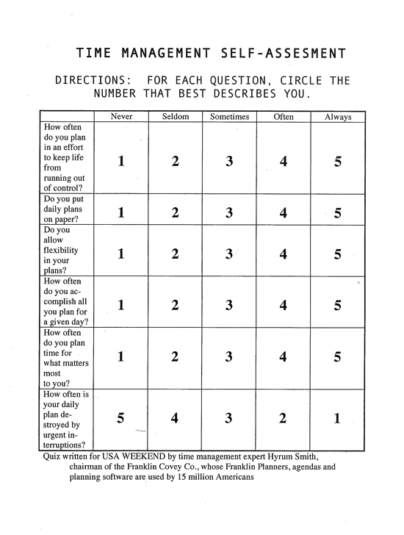

Slide 4
Know how you spend your time…
6-10: Terrible time planner.
You should consider using new tools and processes to help you plan effectively. A great first step would be to take a time management course.
11-15: Below average planner.
You may already have a planning system, but using it more effectively will help to reduce the stress and lack of control you feel in your life.
16-20: Average planner.
Your planning system is working, but you can do better. You may need help focusing on priorities, dealing with urgent interruptions or writing your daily plan.
21-25: Above-average planner.
Your planning system is working well. Keep up the good work, with periodic reviews to be sure you’re planning around what matters most in your life.
26-30: Excellent planner--or candidate for burnout?
You have mastered planning and should experience the serenity that comes from taking charge of your life. But make sure you’re in control of your planning rather than letting it control you.

Slide 5
Protecting your time
Goal Setting: “To-do” or not “to-do” lists
Organize your time into blocks
Identify your “peak productivity” time
Eliminate “time wasters”

Slide 6
Protecting your time
Goal Setting: “To-do” or not “to-do” lists
Organize your time into blocks
Identify your “peak productivity” time
Eliminate “time wasters”

Slide 7
“To Do List” vs “Master List”
Master-list is EVERYTHING you need to do
(may be 20,30,40 or more items)
To –do list is a way of knowing the tasks and demands on your time for TODAY
Invest in a ”planning tool”
electronic planners, pocket diaries, calendars, computer programs, but the best is to always carry a notebook

Slide 8
To-do lists
To-do lists should be captured centrally
(notebook, PD, etc. no sticky notes!)
Maintain and develop a list of specific things to be done for each day*, set your priorities and the get the most important ones done as soon in the day as you can
Evaluate your progress at the end of the day briefly
Prioritize lists
- Eisenhower Matrix
- Must do, Should do, Could do

Slide 9
Eisenhower Matrix
Urgent
Not Urgent
Important
Not
Important
Notes:
Dwight D. Eisenhower was the 34th President of the United States from 1953 until 1961. Before becoming President, he served as a general in the United States Army and as the Allied Forces Supreme Commander during World War II. He also later became NATO’s first supreme commander.
Dwight had to make tough decisions continuously about which of the many tasks he should focus on each day. This finally led him to invent the world-famous Eisenhower principle, which today helps us prioritize by urgency and importance.
How to use the Eisenhower Matrix?
Prioritizing tasks by urgency and importance results in 4 quadrants with different work strategies:

Slide 10
Eisenhower Matrix
-Go to class
-Experiments
-Study for exams
-Collect papers for
review article/ thesis/candidacy exam
-Bake a cake
-Make stock solutions
-Run gels

Slide 11
Must, Should, Could
Submit date sensitive materials (papers, exams, thesis , grants, paper drafts)
Order antibodies
Inject mice
Listen to friends practice talk
Go to seminar
Install and go thru tutorial of new Endnote program
Quantify Western blot
Run PCR

Slide 12
Must, Should, Could
Submit date sensitive materials (papers, exams, thesis , grants, paper drafts) MUST
Order antibodies SHOULD
Inject mice MUST
Listen to friends practice talk COULD
Go to seminar MUST/SHOULD/COULD
Install and go thru tutorial of new software program COULD
Quantify Western blot MUST/SHOULD
Run PCR MUST/SHOULD

Slide 13
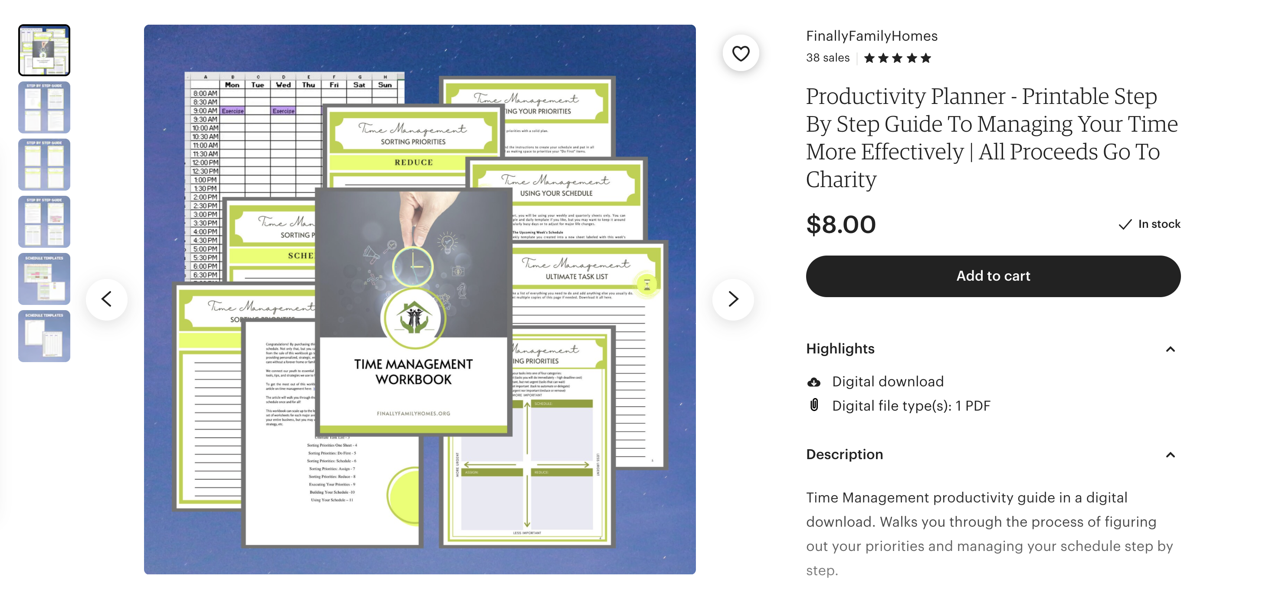

Slide 14
Protecting your time
Make “to-do” lists
Organize your time into blocks
Identify your “peak productivity” time
Eliminate “time wasters”

Slide 15
Time blocks
Focus on one task at a time; in blocks of time and be realistic about constraints on time
Block out time to plan and accomplish high priority tasks
Limit scheduled time to ¾ of your day - unscheduled time is very important!

Slide 16
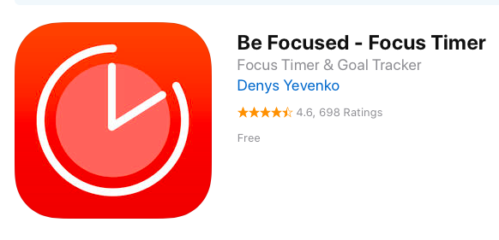
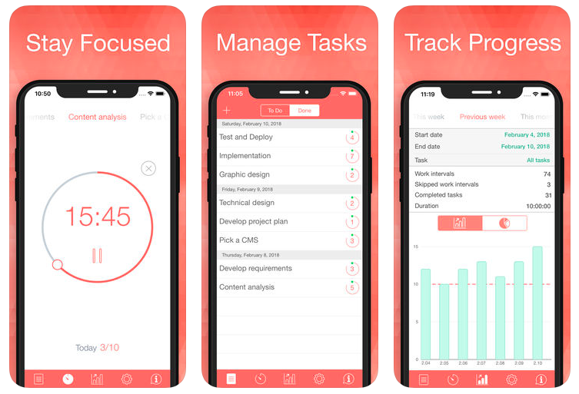
Time blocks and peaks in productivity
Focus on one task at a time; in blocks of time and be realistic about constraints on time
Pomodoro Technique:
Divides work into small
increments with scheduled
breaks

Slide 17
Protecting your time
Make “to-do” lists
Organize your time into blocks
Identify and use your “peak productivity” time
Eliminate “time wasters”

Slide 18
Peak Productivity Time
Studies show the first 2 hours of the day you are
at your cognitively best
-Plan your most challenging tasks for when you have the most energy.
-Course work is pre-arranged but research time is flexible
  - Reading papers and outlining experiments require more concentration=peak productivity slots
  - Some experimental work =non-peak slots
-Block out time for your high priority activities first and protect that time from interruptions.

Slide 19
Interruptions can sabotage your peak productivity times….keep track of who, what and when

Slide 20
Protecting your time
Make “to-do” lists
Organize your time into blocks
Identify your “peak productivity” time
Eliminate “time wasters”

Slide 21
Eliminate “time wasters”
Value your time and be ruthless about safe-guarding it
Manage your inbox
-Don’t let e-mail accumulate to the point that it becomes overwhelming to sort- be intentional
Turn off e-mail notifications.
-Set aside a specific time to view and respond to your mail and e-mail, but don’t let it be a constant drain on your time
-

Slide 22
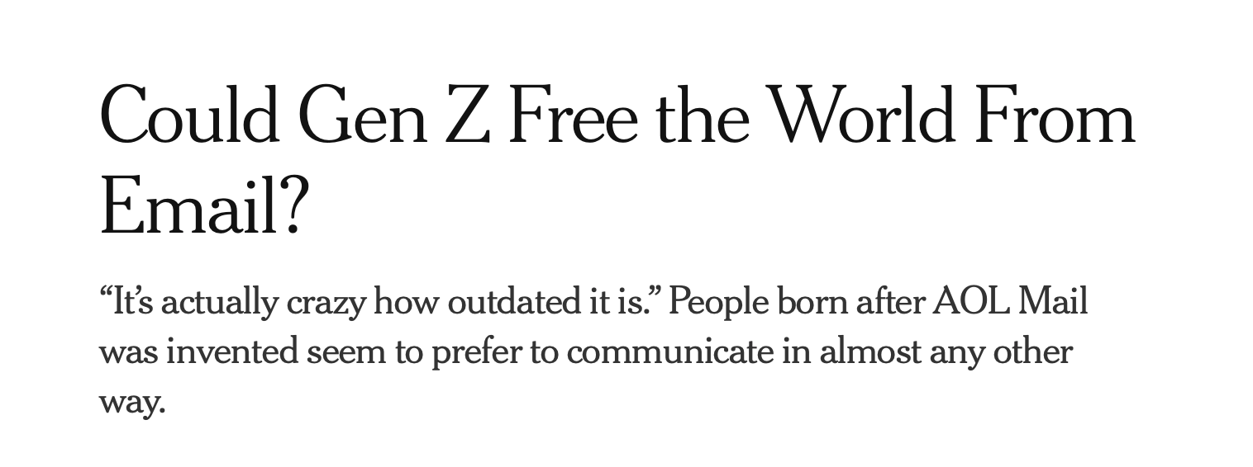
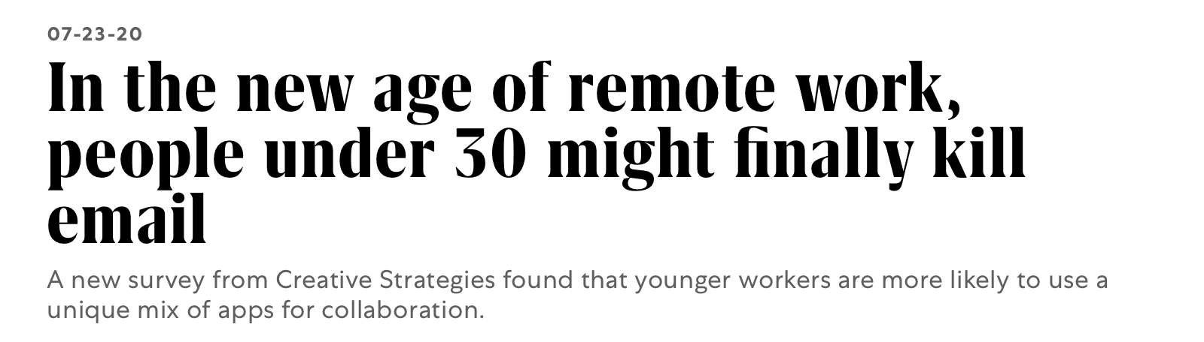

Slide 23
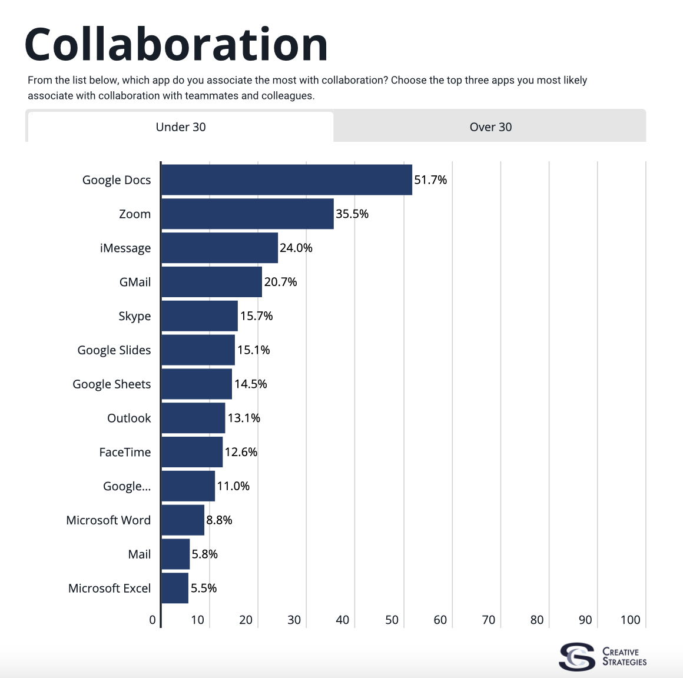
Creative Strategies 2020 Study
Generational gap in primary work tools
For those 30 and above e-mail was among top tools used for collaboration
Under 30 , Google Docs was the app associated most with collaboration

Slide 24
Procrastination
Think about ways you can sabotage your future procrastinating self
Break down tasks into smaller segments that require less time
Set realistic deadlines for each specific accomplishment and reward yourself for completing
Getting started may require some preparatory time (organize papers, talk with experts, clean off your desk)

Slide 25
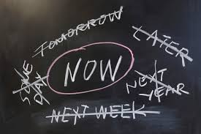
7 Helpful Tips for Time Management
Each day identify your MIT and complete that task first
(Most Important Task)

Slide 26
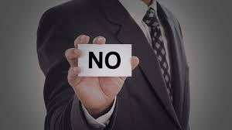
Helpful Tips for Time Management
Learn to say no
“If you want something done , ask the busiest person to do it”
Only take on commitments that you know you have time for and you care about

Slide 27



Helpful Tips for Time Management
Devote your entire focus to the task at hand
close out browser window, put away phone, find the right environment

Slide 28
Helpful Tips for Time Management
Get an early start
Get a good sense of how long tasks take and plan accordingly
Delineate a time limit in which to complete tasks and reward, reward, reward yourself for finishing a given task.

Slide 29
Helpful Tips for Time Management
Be conscientious of amount of internet/social media/ Netflix time
only 1440 minutes in a day, so value each one

Slide 30
Helpful Tips for Time Management
Sleep and exercise and eat healthily

Slide 31
Helpful Tips for Time Management
Pareto Principle- 80:20 rule
- an aphorism which asserts that 80% of outcomes (or outputs) result from 20% of all causes (or inputs) for any given event.
- In business, a goal of the 80-20 rule is to identify inputs that are potentially the most productive and make them the priority.
Identify what are the handful of tasks that are going to pay off the most?

Slide 32

So don’t forget to maintain a good work life balance

